Slide 1
Rapid Object Detection using a Boosted Cascade of Simple Features (Paul Viola , Michael Jones )
Bibek Jang Karki

Slide 2
Outline
Integral Image
Representation of image in summation format
AdaBoost
Ranking of features
Combining best features to form strong classifiers
Cascade classifiers
Test image passing through multiple layers of strong classifiers

Slide 3
Making of Integral Image
Intermediate representation of image to make the area computation fast
Sum of pixels above and left
Mathematical form :

Slide 4
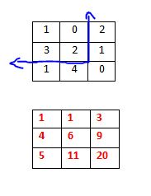
Integral image (example)
Original image
Integral Image

Slide 5
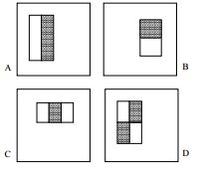
HAAR features
Each feature will do raster scan across image
Area difference between white and gray rectangles will be calculated
Feature based operates faster
Different rectangular features
used

Slide 6
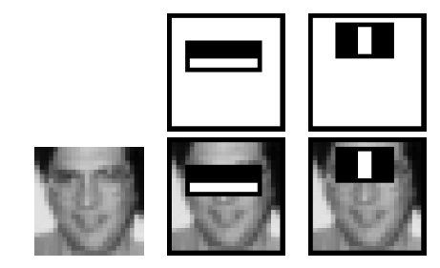
Rectangular features for face detection
Sample best features selected
Comparing difference in intensity
sample features, overlayed in image

Slide 7
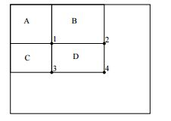
Area calculation
Computing area of rectangle D
Integral image value at different locations given as (1, 2, 3, 4)
D = (A+D) – (B+C)
Area calculation using integral image

Slide 8
AdaBoost Algorithm
Training and features selection
Potential 180,000 feature
Using all features ? Not a good idea !
Selecting subset to make strong classifiers
Algorithm:

Slide 9
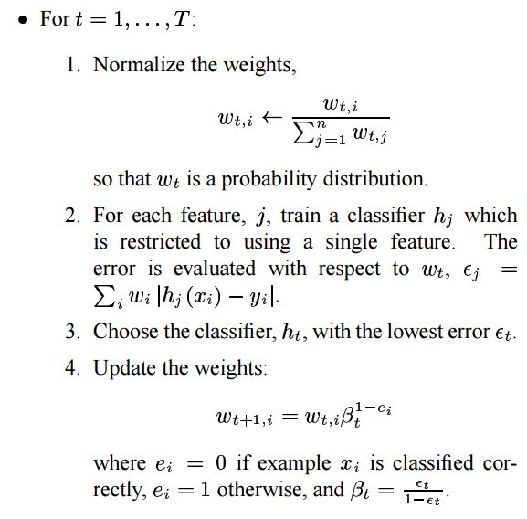
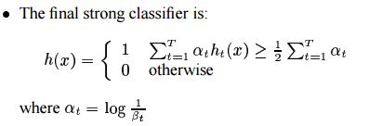
AdaBoost Algorithm
Computing probability
distribution.
Error rate calculation
Finding best features
Weight update
Finally

Slide 10
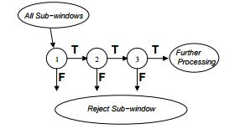
Cascade classifiers
cascade for fast rejection of negative windows
Series of classifiers applied to every sub-window

Slide 11
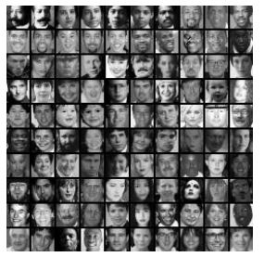
Results
38 layered cascaded classifier used
10 features used for each sub window
700 Mhz Pentium III processor, it can process a 384 by 288 pixel image in .067 seconds
15 times faster than the RowleyBaluja-Kanade detector 600 timesfaster than the Schneiderman-Kanade detector
Sample faces used for training->

Slide 12
Experiments on a Real-World Test Set
s set consists of 130 images with 507 labeled frontal faces
Detection rates for various numbers of false positives

Slide 13
Thank You

